Slide 1
Weight centric mechanism

Slide 2
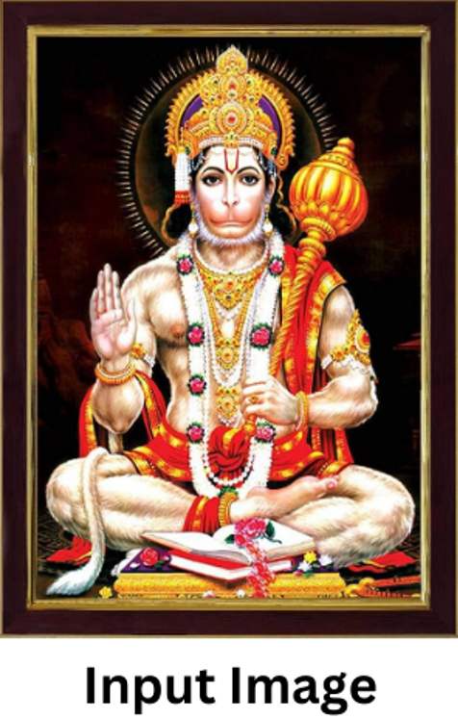

Slide 3
Mobilenet (0.93)
EfficientNet
(0.95)
ResNet
(0.93)
GoogleNet
(0.91)

Slide 4
Mobilenet (0.93)
Class 2 (Ganesha)
EfficientNet
(0.95)
ResNet
(0.93)
GoogleNet
(0.91)
+0.93
Weights
0
0
0
0
0
0
0
0
0
0
0
1
2
3
4
5
6
7
8
9
Classes

Slide 5
Mobilenet (0.93)
Class 2 (Ganesha)
EfficientNet
(0.95)
Class 3
(Hanuman)
ResNet
(0.93)
GoogleNet
(0.91)
+0.95
Weights
0
0
0.93
0
0
0
0
0
0
0
0
1
2
3
4
5
6
7
8
9
Classes

Slide 6
Mobilenet (0.93)
Class 2 (Ganesha)
EfficientNet
(0.95)
Class 3
(Hanuman)
ResNet
(0.93)
Class 3
(Hanuman)
GoogleNet
(0.91)
+0.93
Weights
0
0
0.93
0.95
0
0
0
0
0
0
0
1
2
3
4
5
6
7
8
9
Classes

Slide 7
Mobilenet (0.93)
Class 2 (Ganesha)
EfficientNet
(0.95)
Class 3
(Hanuman)
ResNet
(0.93)
Class 3
(Hanuman)
GoogleNet
(0.91)
Class 9
(Shiva)
+0.91
Weights
0
0
0.93
1.88
0
0
0
0
0
0
0
1
2
3
4
5
6
7
8
9
Classes

Slide 8
Mobilenet (0.93)
Class 2 (Ganesha)
Thus, Final Prediction = Class 3 (Hanuman)
EfficientNet
(0.95)
Class 3
(Hanuman)
ResNet
(0.93)
Class 3
(Hanuman)
GoogleNet
(0.91)
Class 9
(Shiva)
Weights
0
0
0.93
1.88
0
0
0
0
0
0.91
0
1
2
3
4
5
6
7
8
9
Classes
Max
Weighted
Class

